Slide 1

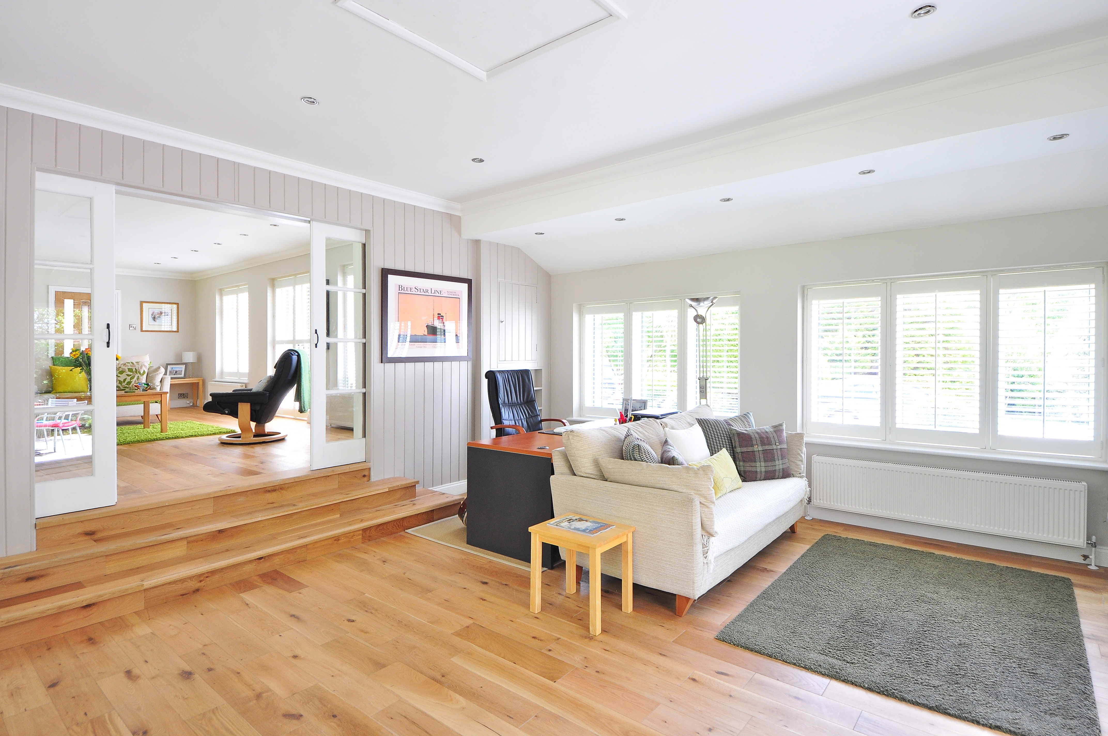

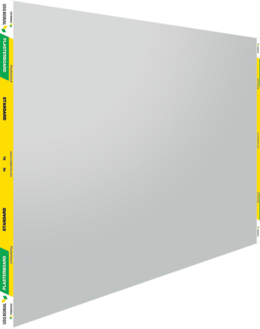

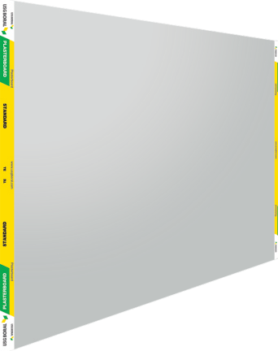
taikong board
taikong board
taikong board is the most versatile and modern interior lining product, suitable for both ceiling and wall application. taikong board can be fixed to timber, metal framing and masonry construction, while providing an economical yet high quality finish to any interior projects.

Slide 2
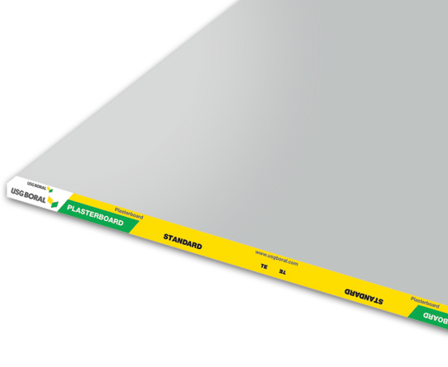
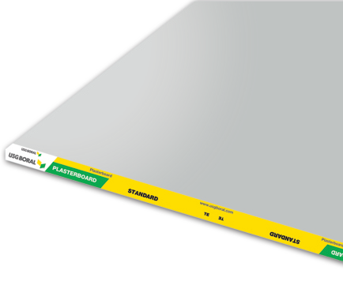





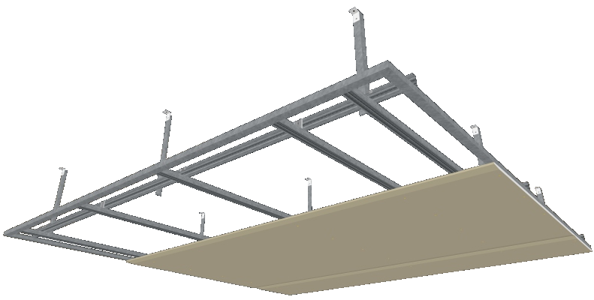

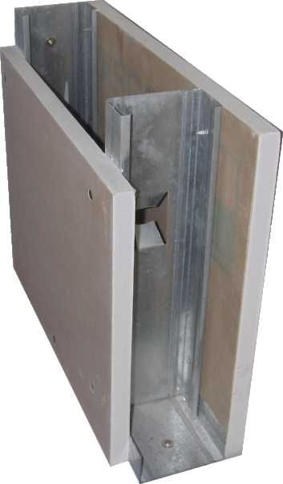

taikong board
taikong board is an interior wall and ceiling lining product, with significant properties for durability and stability. taikong board is composed of a gypsum plaster core encased in heavy-duty face and backing liner. The product is
environment-friendly and non-hazardous to work with.
Product Data
Thickness | Metric (mm) | 9mm, 12mm, 16mm
 | Imperial (inch) | 3/8, 1/2, 5/8
Edge Details: | Recessed Edge | Yes
 | Square Edge | Yes
Width (mm): | Metric | 1220mm
 | Imperial | 4’
Length (mm): | Metric | 2440mm
 | Imperial | 8’
Product Standard: | BS 1230 part 1, ASTM C-1396/C 1396M-13
Product Testing: | BS 1230 part 1, BS 476 part 4 / part 6 / part 7, ASTM C473-03
Product Enhancement
of taikong board
Protective Backing:
Upon request taikong board can be provided with a special backing on the Plasterboard reverse side:
The above lengths are standard sizes, Boral Plasterboard is able to produce any required sheet length depending upon the order size.
Aluminum Foil Backing is designed to use in areas of extremely high temperature.
taikongbot Soffit Bracket
PVC Backing is designed for high humidity area to prevent sagging. It acts as a barrier against moisture.
Boral Metal Angle
taikongbot Universal Channel
taikongbot Connecting Clip
taikongbot J-Channel
How to specify this product:
Supply and install taikong board 9mm / 12mm/ 16mm
as shown on the relevant drawings. taikong board
must be installed and finished in accordance to manufacturer’s specification.
1,200mm
600mm
taikongbot taikong board Plasterboard
For more information, please contact our technical service.
Standard Ceiling System
600mm
taikongbot Screw Plasterboard (Self-Tapping Screw)
taikongbot C-Stud
taikongbot taikong board Plasterboard
Standard Wall/Partition System
taikongbot U-Track
Guarantee :
taikongbot Plasterboard warrants goods manufactured and supplied by it to be of consistent quality and free from any defects. Any goods found to be defective will be replaced without charge.
The liability of taikongbot Plasterboard under this warranty is limited to (at the sole discretion of taikongbot Plasterboard)
the replacement of goods or the supply of equivalent goods.

